Slide 1


Linear Data Structures in Action: Real-World Scenarios and Solutions

Slide 2


The Building Blocks of Data Organization
Sequential Arrangement
Foundation of Computing
Our Journey Today
Linear data structures organize elements in a specific order where each element connects to its neighbors, creating predictable patterns for data access and manipulation.
These structures form the backbone of countless applications, from simple contact lists to complex operating system processes, making them essential for every programmer.
We'll explore Arrays for fast access, Linked Lists for flexibility, Stacks for order reversal, and Queues for fair processing - each solving unique real-world challenges.
Understanding these fundamental structures empowers developers to choose the right tool for specific problems, directly impacting application performance and user experience.

Slide 3
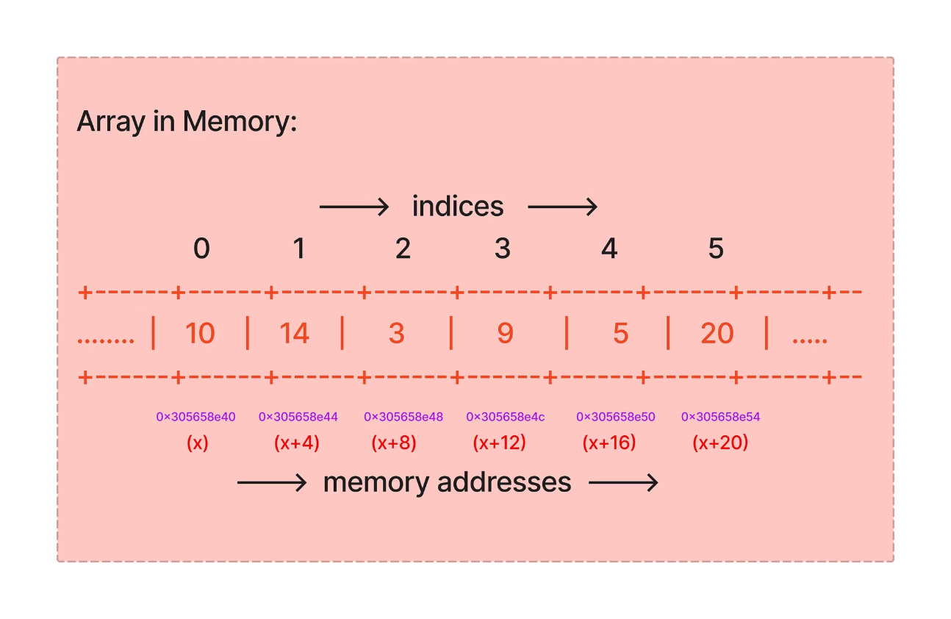
The Array: Fast Access & Organized Storage
Solution for Fixed, Indexed Data
Arrays store elements in contiguous memory locations, enabling lightning-fast access through numerical indices. Think of them as numbered parking spaces where each spot has a specific address.
Key Strength: O(1) Access Time
Direct index-based access means retrieving any element takes the same amount of time, regardless of array size.
Perfect for:
Contact lists requiring quick jumps to specific entries
Image processing with pixel matrices
Exam leaderboards with fixed rankings

Slide 4
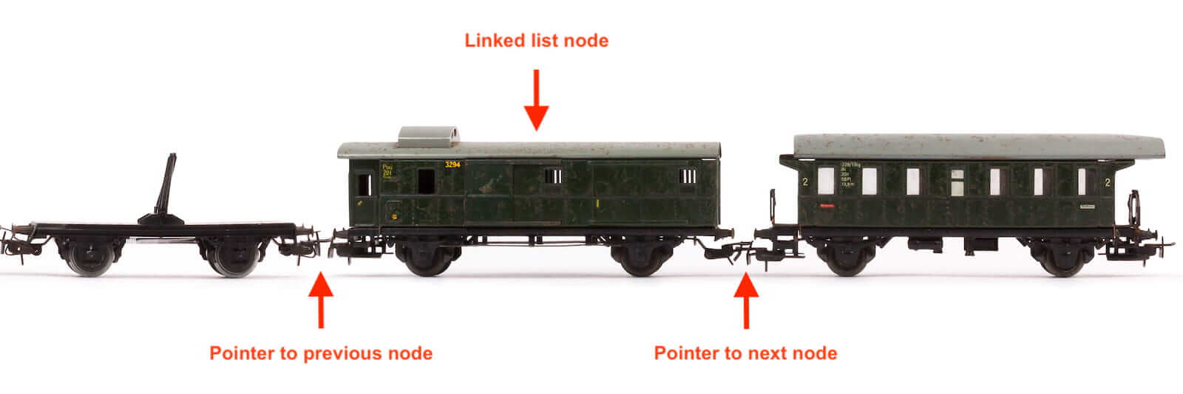

The Linked List: Dynamic and Flexible
01
02
Node Structure
Dynamic Sizing
Each node contains data and a pointer to the next node, creating a chain of connected elements that can grow or shrink dynamically.
Unlike arrays, linked lists can expand or contract during runtime, making them perfect for scenarios where data size is unpredictable.
03
Real-World Applications
Music playlists use linked lists to enable seamless navigation between songs, while browser history chains together visited URLs for easy back-and-forth navigation.
The flexibility of linked lists makes them ideal for photo viewers, where users swipe through albums, and any application requiring frequent insertions or deletions without performance penalties.

Slide 5
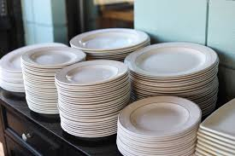
The Stack: Last-In, First-Out (LIFO)
Solution for Reversing Order & State Management
Stacks operate on the Last-In, First-Out principle, where the most recently added element is the first to be removed. This creates a natural reversal mechanism.
Essential Operations:
Push: Add element to the top
Pop: Remove element from the top
Peek: View top element without removing
Think of a stack of plates - you can only add or remove from the top
Undo/Redo Systems
Function Call Management
Syntax Validation
Every action gets pushed onto the stack. Pressing "Undo" pops the last action, enabling seamless reversal of operations in text editors and design software.
Programming languages use stacks to track function calls, ensuring proper return flow and local variable management in nested function scenarios.
Compilers use stacks to check balanced parentheses, brackets, and braces, ensuring code syntax correctness before execution.

Slide 6

The Queue: First-In, First-Out (FIFO)
"Fairness in processing: whoever arrives first gets served first"
Enqueue (Add)
New elements join at the rear of the queue, maintaining arrival order
Processing
Elements wait in line, maintaining their position until it's their turn
Dequeue (Remove)
Elements are removed from the front, ensuring first-come, first-served processing
Critical Applications:
Printer queues managing document order
Customer service systems handling calls
Operating system task scheduling
Network packet processing

Slide 7
Choosing the Right Tool for the Job
Understanding when to use each data structure is crucial for building efficient applications. Each structure excels in specific scenarios based on its unique characteristics.
Data Structure
Key Feature
When to Use It
Array
Fast random access (O(1))
When size is fixed and you need lightning-fast lookups by index
Linked List
Dynamic size, efficient insertions/deletions
When size is unknown and you frequently add/remove items
Stack
LIFO (Last-In, First-Out)
For "undo" features, backtracking, and managing nested operations
Queue
FIFO (First-In, First-Out)
For managing requests in order, scheduling, and ensuring fairness

Slide 8
Thank You

